Slide 1


ExcelR
Zomato Analysis
By: Group 6
Mohammed Junaid, Ranchi G Jain, Garima Gaurav Parate, Soumya P F, Divyansshi Sharma.

Slide 2


Introduction
Zomato is a food delivery network. It serves as an integral link between customers and restaurants worldwide.
Zomato offers various services by delivering meals right to the customer’s doorstep.
Zomato relies on user-generated content, with reviews and ratings playing a significant role

Slide 3
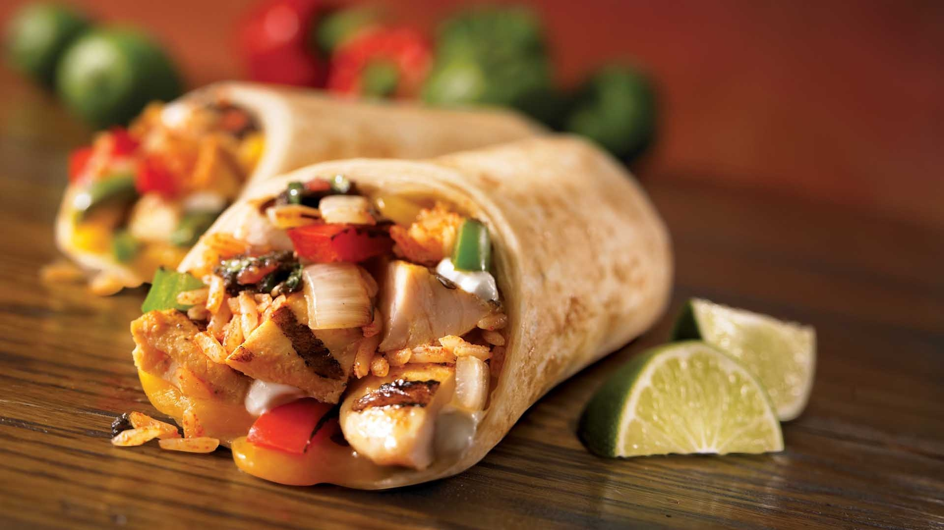
Objectives
We have utilized advanced Excel functions and SQL queries to analyze the data.
The dashboards were created using Power BI and Tableau to visualize insights.

Slide 4

Problems faced by company
Zomato faced increased competition during the peak season from other food delivery platforms offering similar services.
Zomato's pricing strategy during the festive season could have been perceived as unaffordable or not competitive, leading to a decrease in demand.
The online food delivery market has very tough competition. These harsh conditions make life difficult for the company in order to grow

Slide 5

Data modelling
Aggregated columns are created for common date-based metrics such as Year-month, Quarter, Month ,Year, Date-key.
Defining relationships and dependencies between different data entities, such as customers, restaurants, and orders.
For uniform analysis, currency values are converted to a base currency.
For visualization charts, graphs, pivot tables and dashboards to represent key findings.Utilize tools like Tableau or Power BI for interactive and dynamic visualizations.

Slide 6
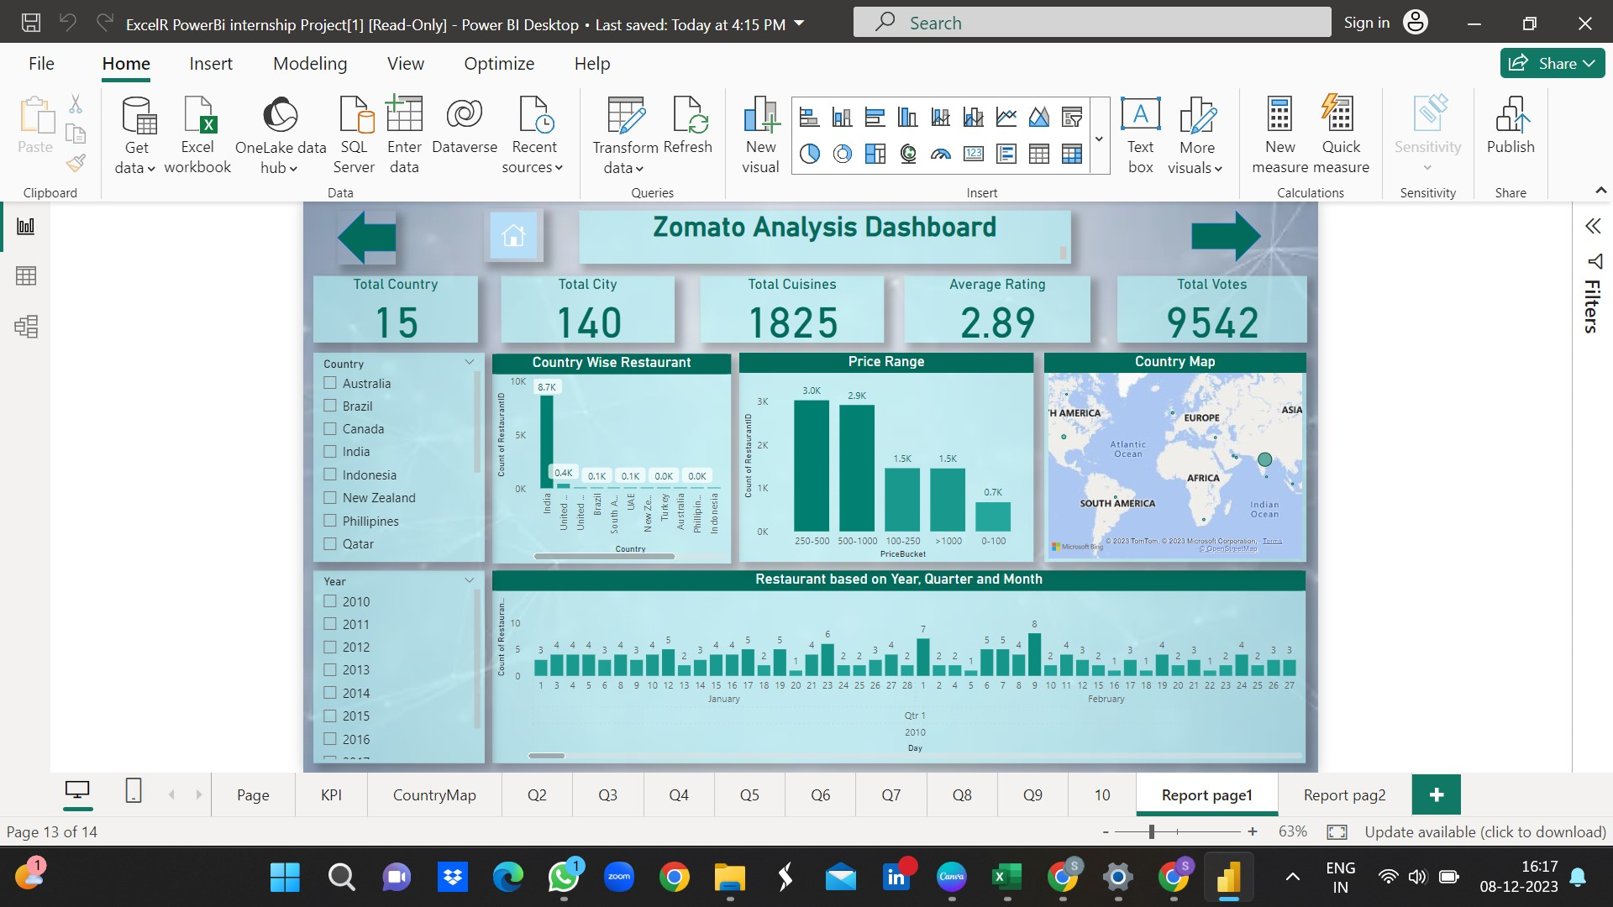
Dashboard
1.

Slide 7
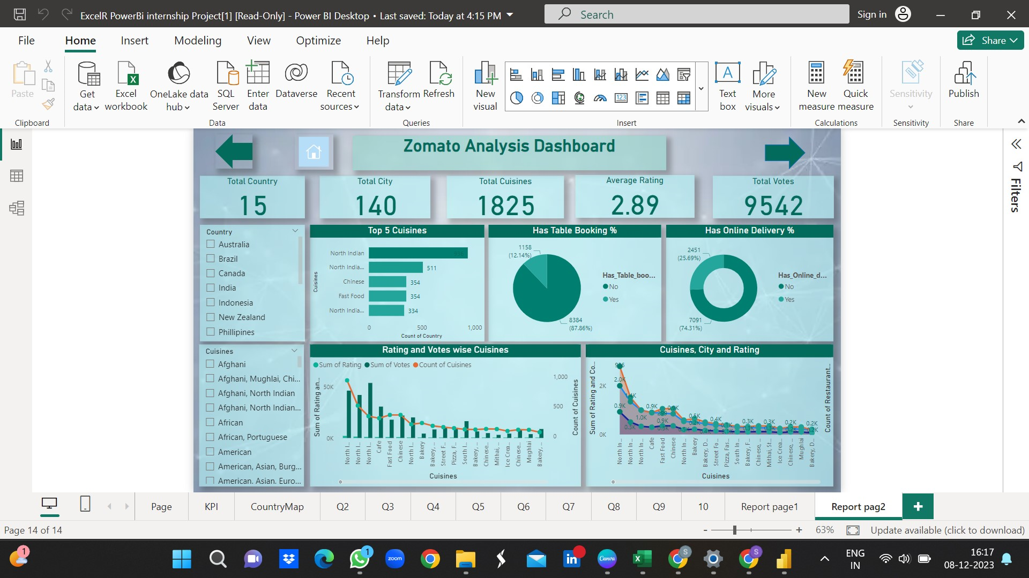
2.

Slide 8

Conclusion
Zomato is better positioned to enhance the overall user experience for online food delivery and restaurant discovery
Top restaurants based on a combination of ratings, reviews, and order volumes as well as percentage of table booking and online delivery have been identified using Excel, Sql, Tableau and PowerBi.
Suggestion
To enhance performance of the restaurants on Zomato, they have engage with users, implement data-driven marketing strategies, improve overall food quality.
Optimize delivery routes further by considering real-time traffic data, weather conditions.Minimize delivery times and enhance overall delivery experiences

Slide 9
Thankyou

